Slide 1
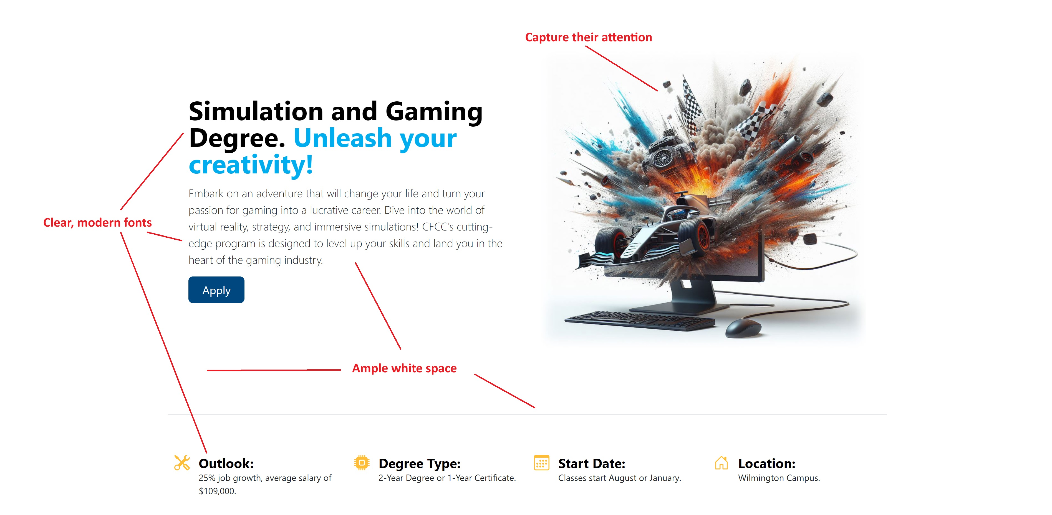
This slide shows some of my design choices. I used best practices like clear modern fonts, interesting pictures, and ample white space. The page also has consistent columns and layouts as you scroll down. I used the colors from the CFCC style guide to ensure a consistent look with other CFCC web pages and material.
Notes:
This slide shows some of my design choices. I used best practices like clear modern fonts, interesting pictures, and ample white space. The page also has consistent columns and layouts as you scroll down. I used the colors from the CFCC style guide to ensure a consistent look with other CFCC web pages and material.

Slide 2
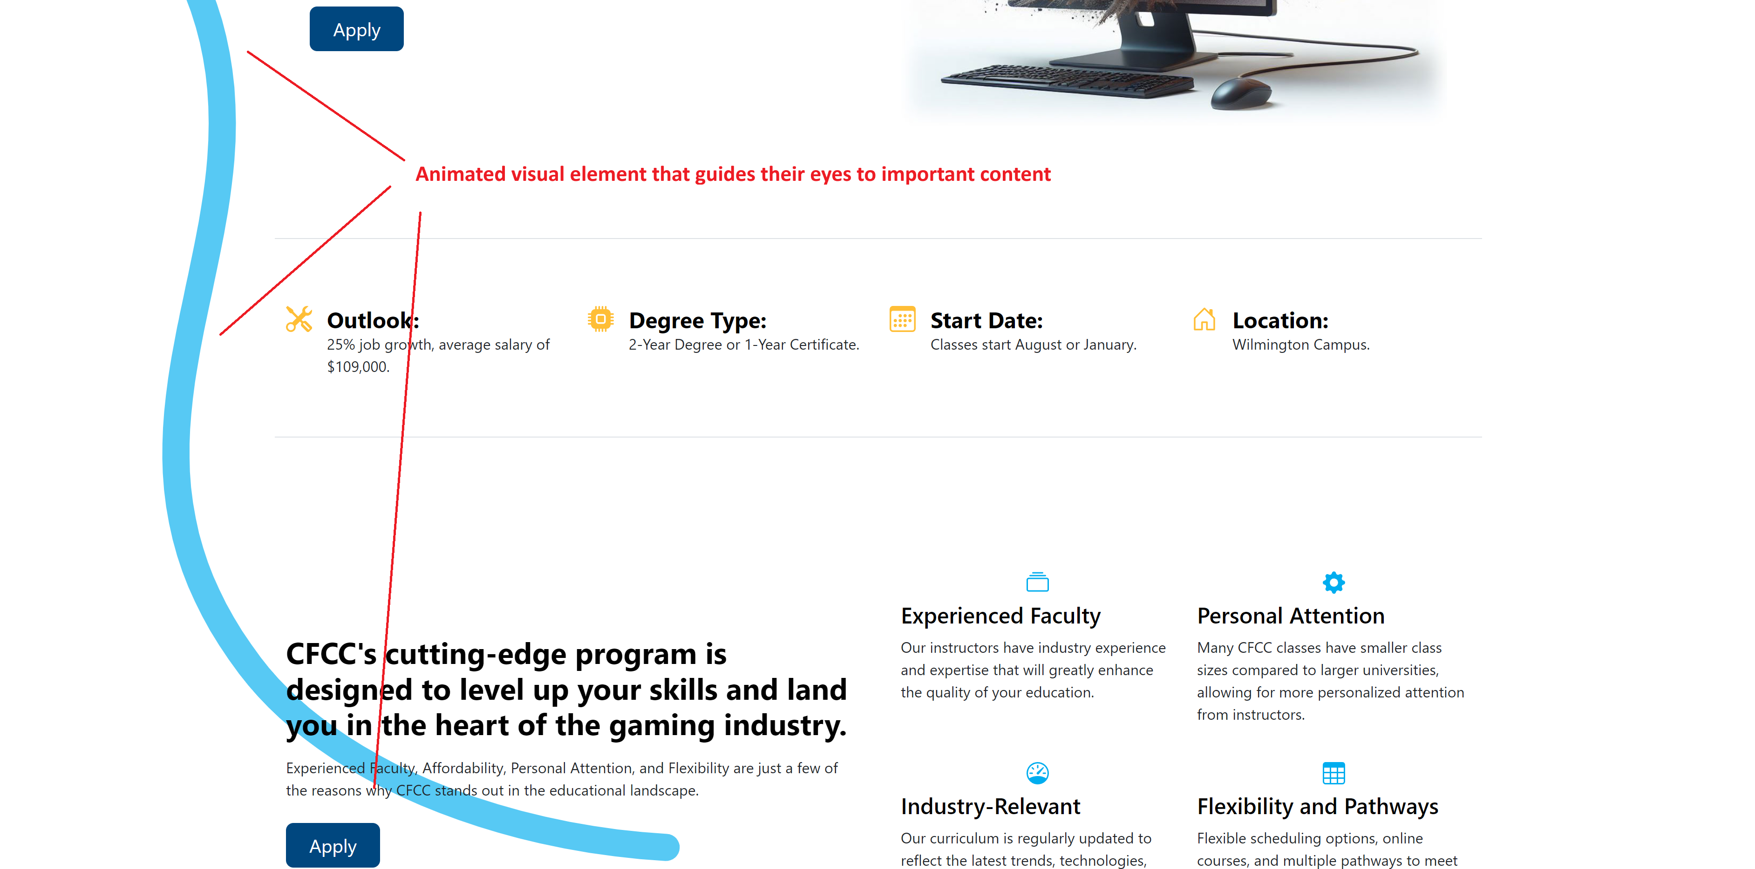
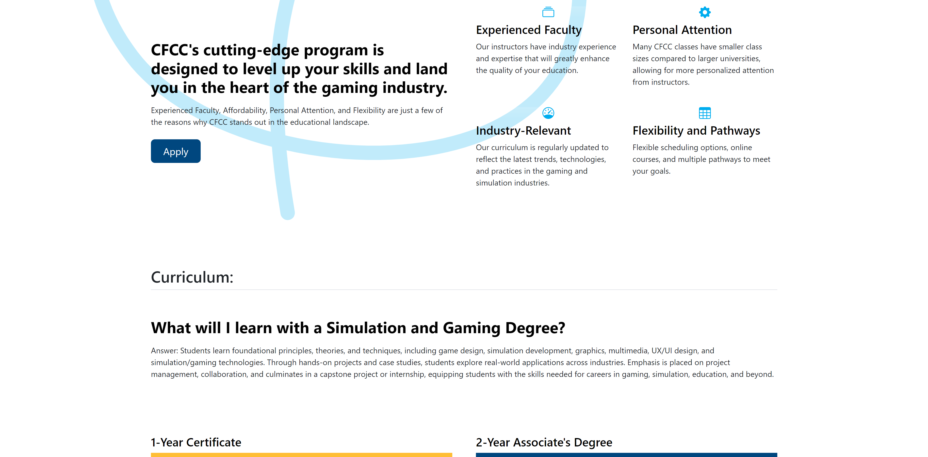
My attempt at innovation: The animated blue ribbon guides students’ eyes to important and compelling content and then fades out.
Notes:
My attempt at innovation: The animated blue ribbon guides students’ eyes to important and compelling content and then fades out.

Slide 3
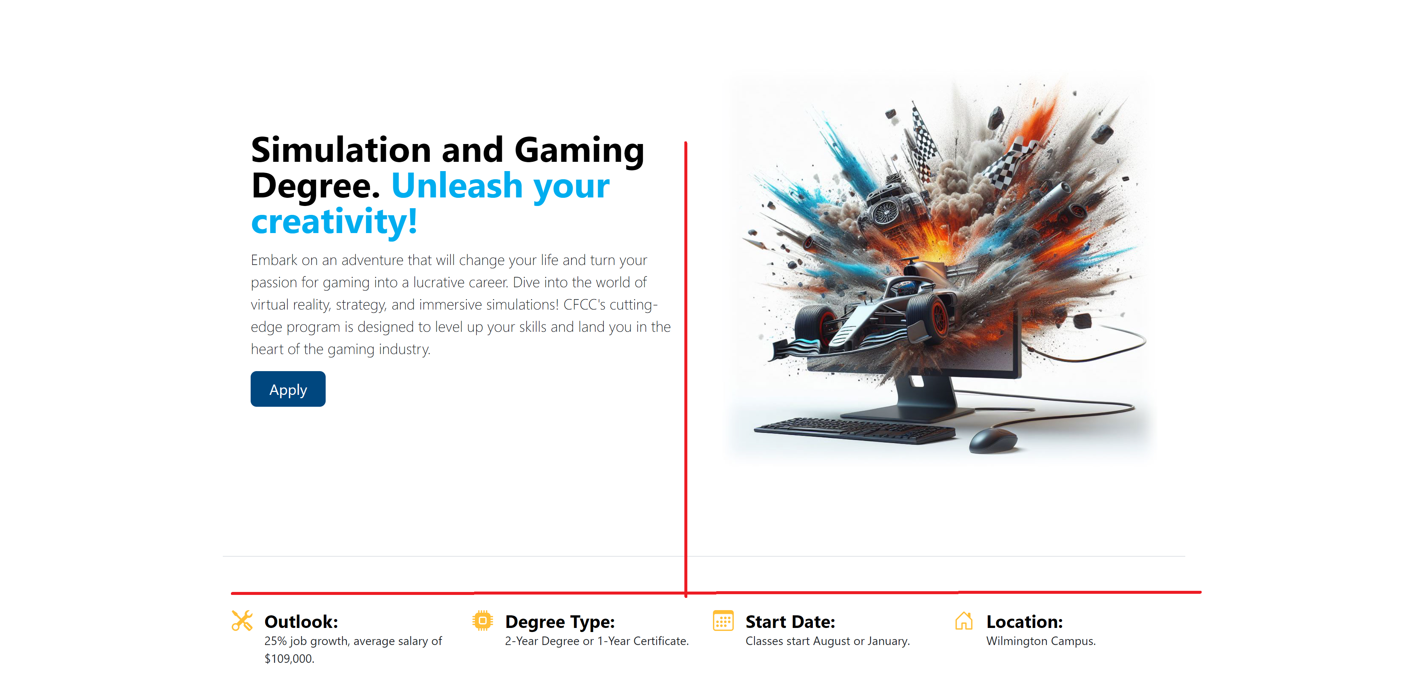
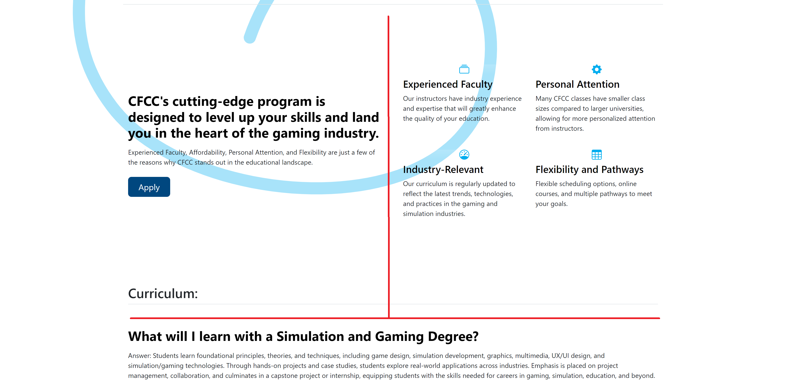
Notes:
Showing the consistent layout as you scroll.

Slide 4
This slide shows some of my choices for content selection. I used a catchy headline that grabs attention, a clear call to action, concise and focused content, and visually appealing images/text.
Notes:
This slide shows some of my choices for content selection. I used a catchy headline that grabs attention, a clear call to action, concise and focused content, and visually appealing images/text.

Slide 5
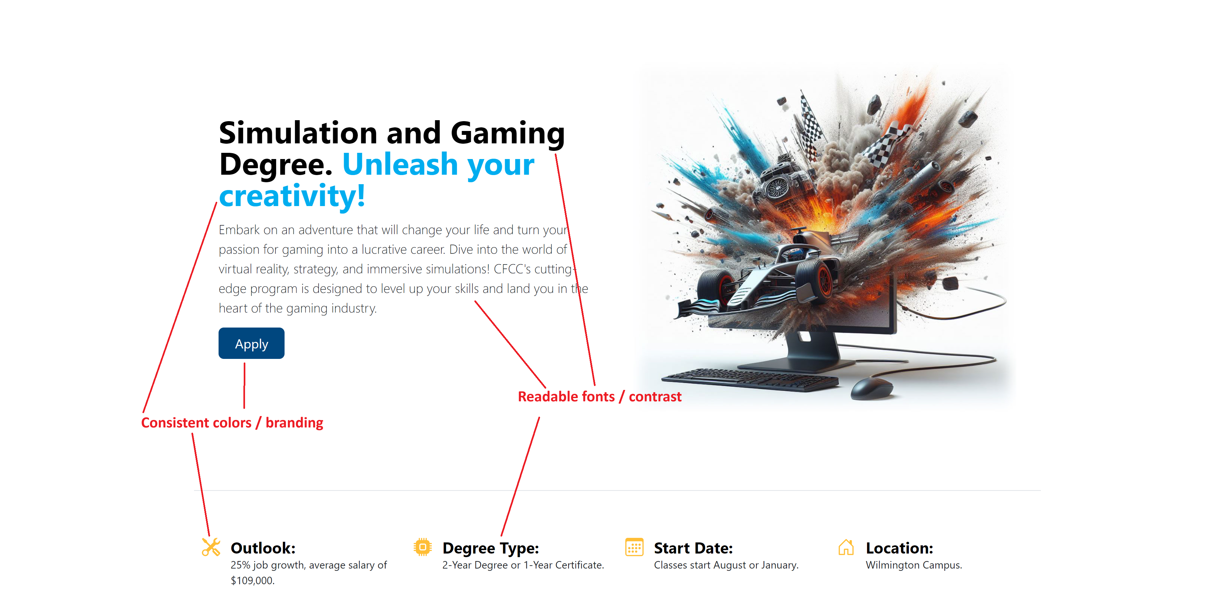
This shows some of the UI and UX elements. I kept consistent colors and branding, readable and accessible fonts, and present information in a clear way (using white space and a single call to action).
Notes:
This shows some of the UI and UX elements. I kept consistent colors and branding, readable and accessible fonts, and present information in a clear way (using white space and a single call to action).

Slide 6
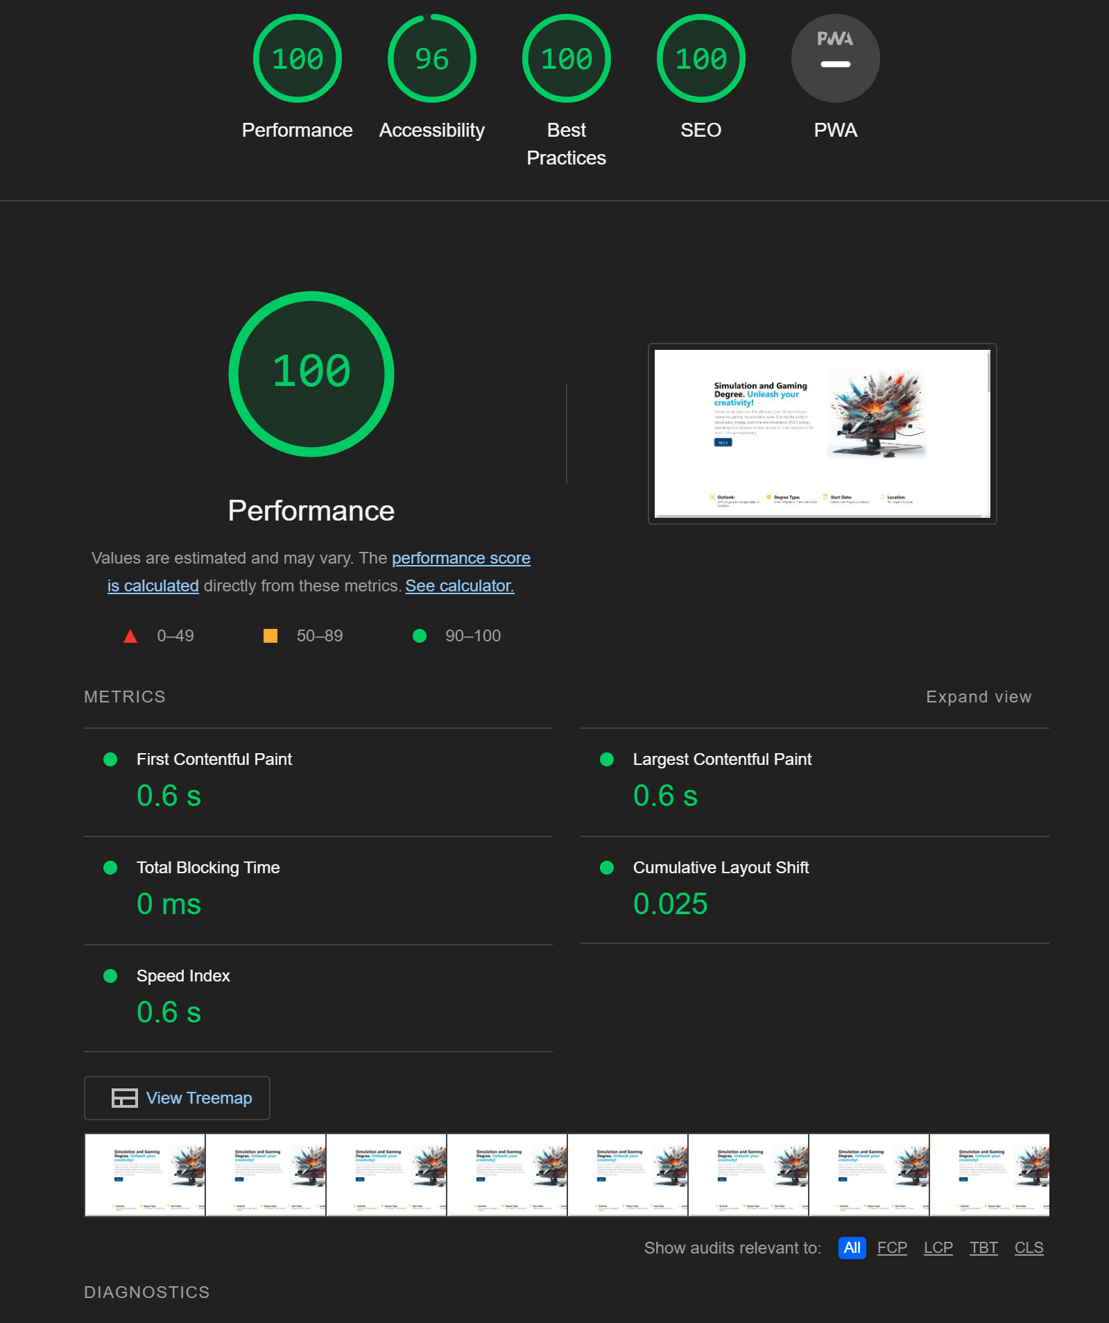

This slide shows some of the web design best practices. The page is built responsive and is designed for mobile devices. It also has fast page loads, accessibility best practices (such as alt text for images) and SEO best practices (appropriate use of H1, H2 for example).
Notes:
This slide shows some of the web design best practices. The page is built responsive and is designed for mobile devices. It also has fast page loads, accessibility best practices (such as alt text for images) and SEO best practices (appropriate use of H1, H2 for example).

